Slide 1
GRAPHS

Slide 2
Definition
A graph G consists of two sets V & E.
V is a set of Vertices and
E is a set of pair of vertices.
G =(V,E) - a graph representation
(V₁,V₂) - an edge representation

Slide 3
A sample graph
0
1
0
1
Edge
2
3
2
3
Vertex
G1
G2
4
(a) Undirected graph
(b) Directed graph

Slide 4
Set Representation
V(G₁) = { 0,1,2,3 },
V(G₂) = { 0,1,2,3,4 }
E(G₁) ={ (0,1),(0,2),(1,2),(1,3),(2,3) }
E(G₂) ={(0,1),(0,2),(1,1),(1,3),(1,4), (2,1),(2,4),(3,4) }

Slide 5
Graph : Basic Terminologies
i) A complete graph is a graph with maximum number of edges.
ii.) Maximum no of edges for undirected graph with vertices is the number of distinct unordered pairs (Vi,Vj;i≠ j) is n(n-1)/2.
iii.) For a directed graph of n vertices the maximum no of edges is n(n-1).
i

Slide 6
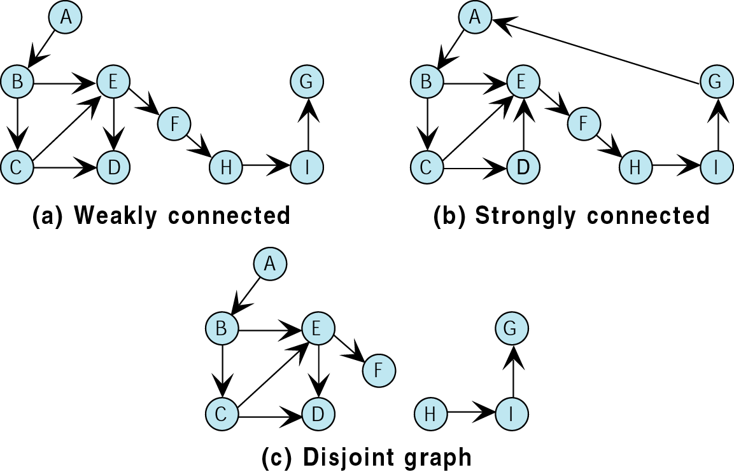
Figure 12-2

Slide 7
Terminology
If v₁ and v₂ are connected, they are said to be adjacent vertices
    v₁ and v₂ are endpoints of the edge {v₁, v₂}
If an edge e is connected to v, then v is said to be incident on e. Also, the edge e is said to be incident on v.
{v₁, v₂} = {v₂, v₁}
A
B
This means {A,B} only, not {B,A}

Slide 8
Graph : Basic Terminologies
If (V₀,V₁) is an edge is an undirected graph, then the vertices V₀,V₁ are adjacent and the edge (V₀,V₁) is incident on vertices V₀ and V₁.

Slide 9
Graph : Basic Terminologies
A path from vertices V₁ to V_{n} in a graph G is a sequence of vertices, V₁,V₂,…. ,V_{n-1} such that (V₁,V₂) …. (V_{n-1}, V_{n}) are edges in an undirected graph.
A length of path is the number of edges on it.

Slide 10
Graph : Basic Terminologies
A directed graph is strongly connected if, for every pair of vertices V_{i}, V_{j} in V(G), there is a directed path from V_{i} to V_{j} and also from V_{j} to V_{i}.
1
2

Slide 11
Graph : Basic Terminologies
The degree of a vertex - Number of edges incident to that vertex.
In-degree of a vertex V(For directed graph) - Number of edges that has V as the head.
Out-degree of a vertex V (For directed graph) - No of edges that has V as tail.

Slide 12
Graph : Basic Terminologies
  Degree of Vertex 1 in G1 is 3.
  In-degree of a vertex in G2 is 2.
  If d_{i} is the degree of a vertex i in graph G with n vertices and e edges, then the number of edges is
        n-1
      e = ( ∑ d_{i}) /2
      0

Slide 13
Graph Representation
Two popular computer representations of a graph. Both represent the vertex set and the edge set, but in different ways.
  Adjacency Matrix
    Use a 2D matrix to represent the graph
  Adjacency List
    Use a 1D array of linked lists

Slide 14
Graph Representation
Adjacency Matrix.
Adjacency Lists

Slide 15
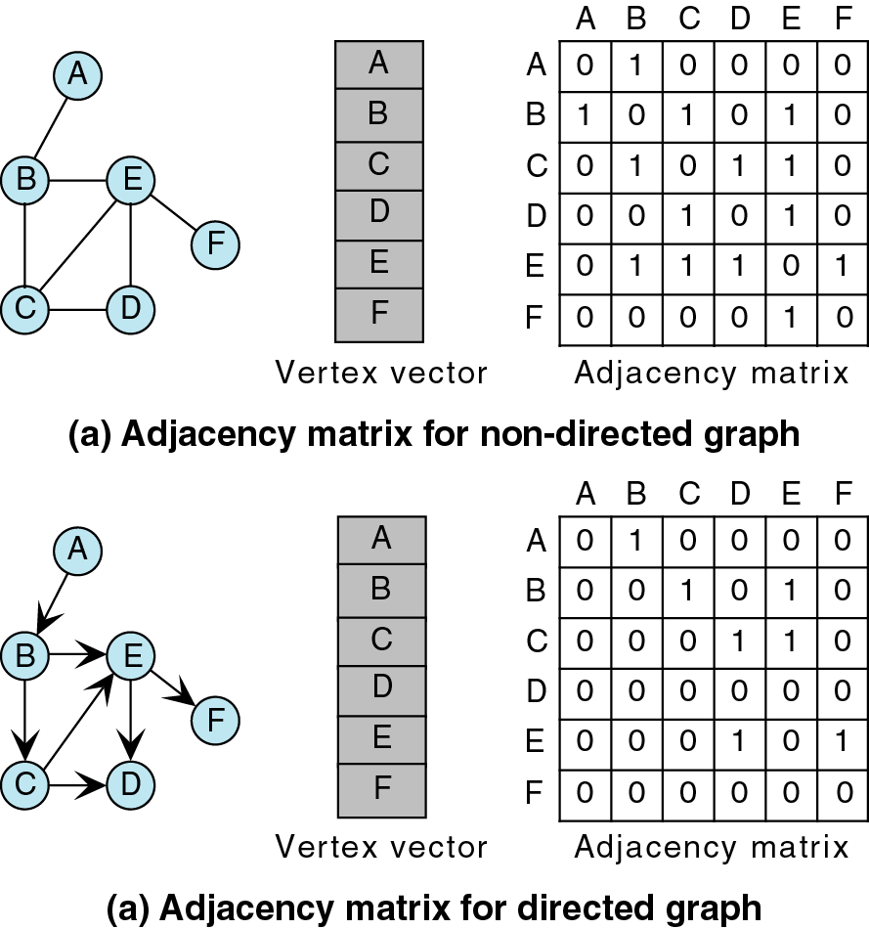
Figure 12-12

Slide 16
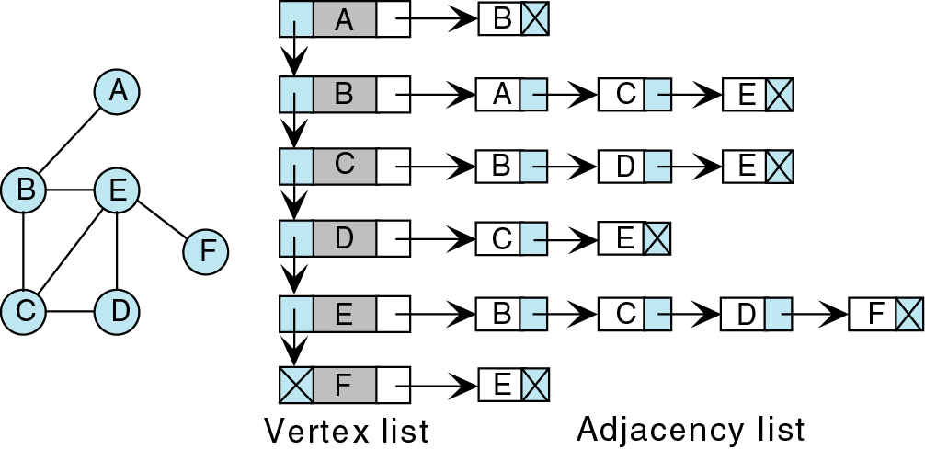
Figure 12-13

Slide 17
Graph Traversal
Application example
  Given a graph representation and a vertex s in the graph
  Find all paths from s to other vertices
Two common graph traversal algorithms
    Breadth-First Search (BFS)
      Find the shortest paths in an unweighted graph
    Depth-First Search (DFS)
      Topological sort
      Find strongly connected components

Slide 18
Depth First traversal
It starts by processing the first vertex of the graph.After processing it, we select any vertex adjacent to the first vertex & process it.
We will continue until we reach a vertex with no adjacent entries.
We require a stack to complete the traversal as we move to process vertices.
The order in which the vertices are processed depends on how they are physically stored.
However the traversal will follow the LIFO order.

Slide 19
We begin by pushing the first vertex A ,into the stack.
We then loop, popping the stack & after processing the vertex, pushing all of the adjacent vertices into the stack.
When the stack is empty, traversal is complete.

Slide 20
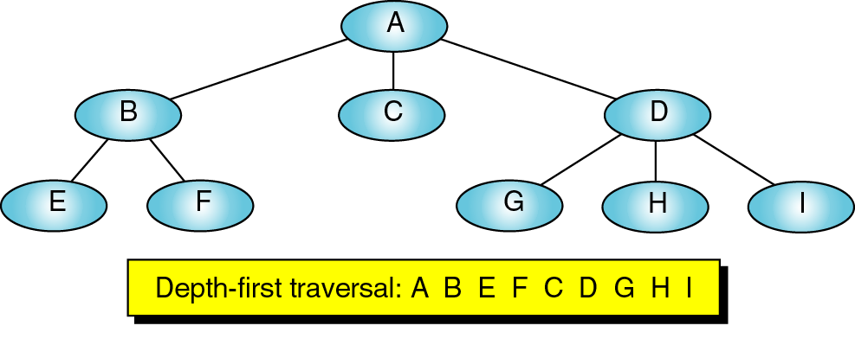
Figure 12-8

Slide 21
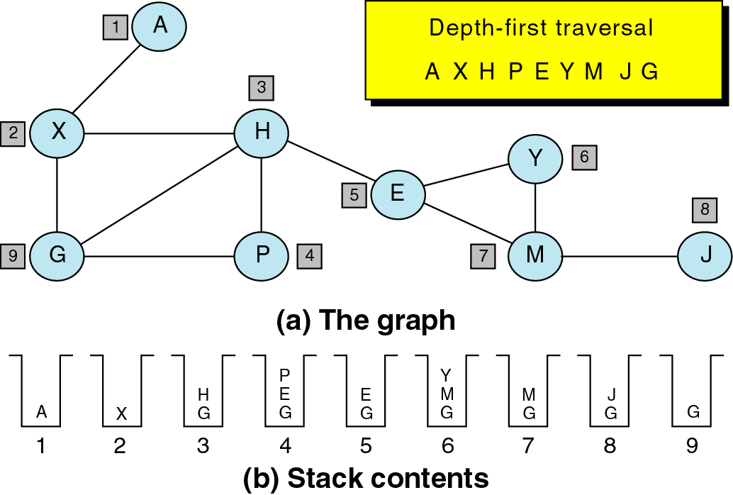
Figure 12-9

Slide 22
Algorithm -DFS
Initialize all nodes to READY state (status=1)
Push starting node A on stack ,change status to waiting state .(STATUS=2)
Repeat steps 1 & 2 until stack empty
  1. Pop the top node N of stack. Process N & change its status to processed state (STATUS=3)
  2 Push on stack all neighbours of N that have ready state (STATUS=1) & change the status to waiting state (STATUS =2)
  End of loop
  Exit.

Slide 23
Breadth First traversal
In this traversal,all the adjacent vertices of a vertex are processed before going to next level.
It uses a queue data structure as each vertex is procesed we place all of its adjacent vertices in a queue & we need to process each vertex in FIFO order.

Slide 24
We begin by enqueuing vertex A in the queue.
We then loop,dequeuing the queue& processing the vertex from the front of the queue.After processing the vertex,we place all adjacent vertices in queue.
When the queue is empty,traversal is complete.

Slide 25
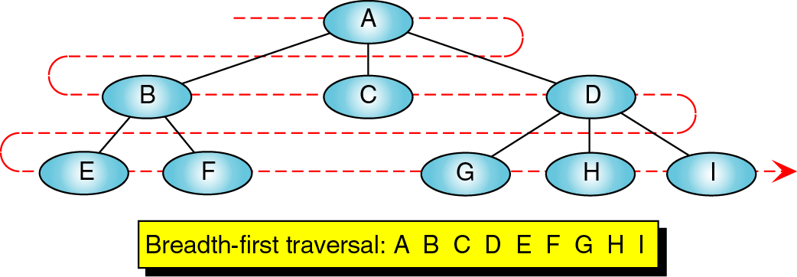
Figure 12-10

Slide 26
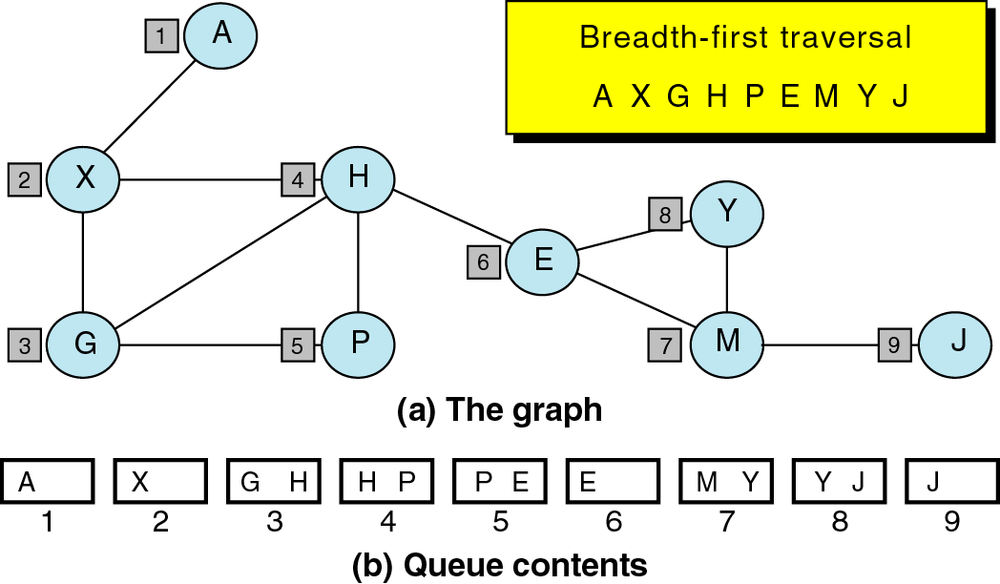
Figure 12-11

Slide 27
Algorithm BFS
Initialize all nodes to READY state (status=1)
Push starting node A in QUEUE ,change status to waiting state .(STATUS=2)
Repeat steps 1 & 2 until QUEUE is empty
  1. Remove the front node N of QUEUE. Process N & change its status to processed state (STATUS=3)
  2 ADD to REAR of QUEUE all neighbours of N that have ready state (STATUS=1) & change the status to waiting state (STATUS =2)
  End of loop
  Exit.

